Slide 1
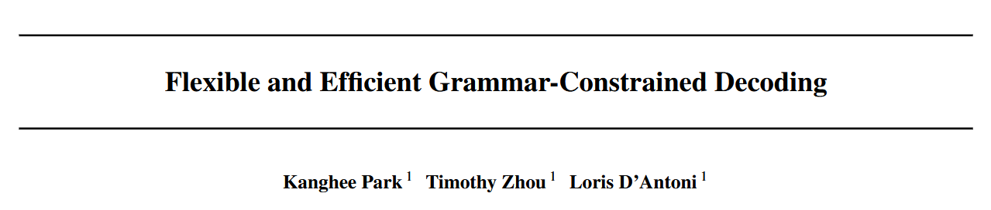

Slide 2

Authors

Slide 3
Abstract
Grammar-Constrained Decoding
Guarantee that LLM outputs matches a context-free grammar
Generate a mask of illegal tokens on every time step
Challenge
LLM subword tokenizer is not aligned with the CFG tokens
Hard to do it efficiently
Contribution
17.71x faster offline preprocessing
SOTA efficiency in online mask computation

Slide 4
Background
Constrained decoding. mask out illegal tokens on every time step.
Grammar-constrained decoding. use a grammar as the constraint.
How most CFG parsers work:
afl = [[1]]
Source code
lexer
NAME(afl) OP(=) OP([) OP([) NUMBER(1) OP(]) OP(])
Terminals
parser
passed
AST

Slide 5
Key challenge: misalignment
af|l| =| [[|1|]]
LM tokens
Tokens used by LM tokenizers do not align with the terminals used by parsers.
LM tokenizer
afl = [[1]]
Source code
lexer
NAME(afl) OP(=) OP([) OP([) NUMBER(1) OP(]) OP(])
Terminals
Therefore, GCD approaches either incur high online token-masking overhead (>1s / token) or high offline preprocessing costs (> 30min).
parser
passed
AST

Slide 6
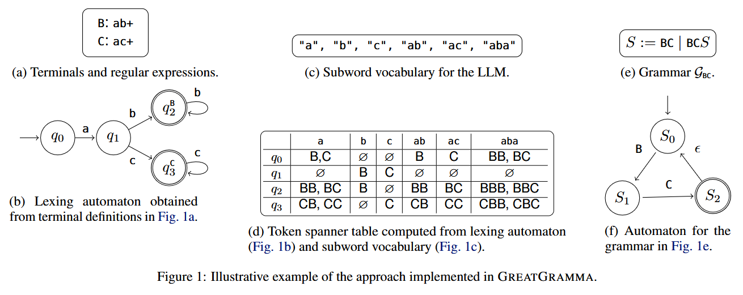
Approach

Slide 7
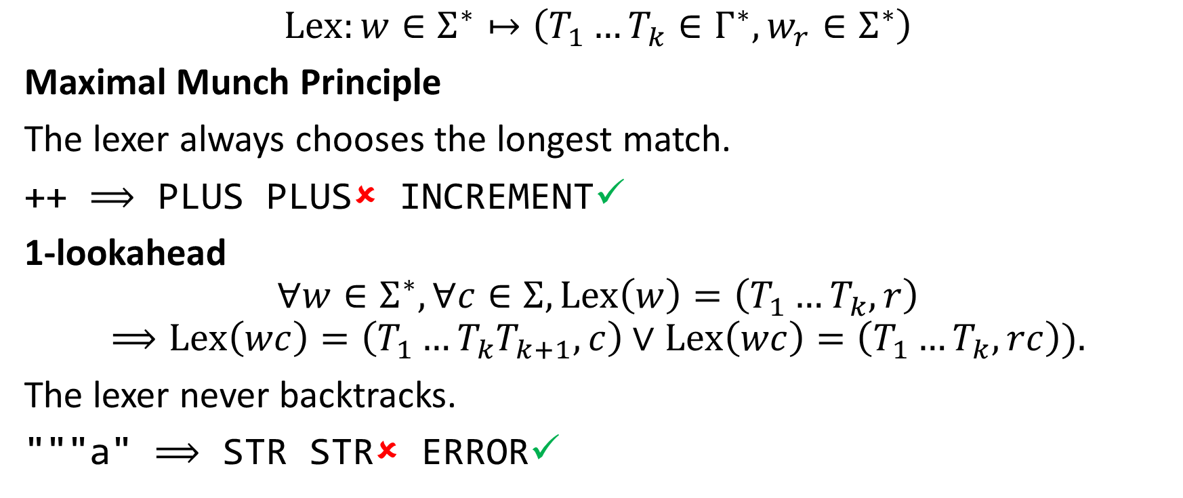
Lexer assumptions
$$Lex:w∈Σ^{∗}↦\left(T_{1}…T_{k}∈Γ^{∗},w_{r}∈Σ^{∗}\right)$$
Maximal Munch Principle
The lexer always chooses the longest match.
++ $⟹$ PLUS PLUS✗ INCREMENT✓
1-lookahead
$$∀w∈Σ^{∗},∀c∈Σ,Lex\left(w\right)=\left(T_{1}…T_{k},r\right)$$
$$⟹Lex\left(wc\right)=\left(T_{1}…T_{k}T_{k+1},c\right)∨Lex\left(wc\right)=\left(T_{1}…T_{k},rc\right)).$$
The lexer never backtracks.
"""a" $⟹$ STR STR✗ ERROR✓

Slide 8
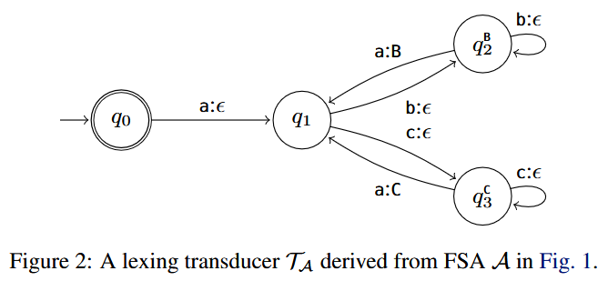
Lexing transducer

Slide 9
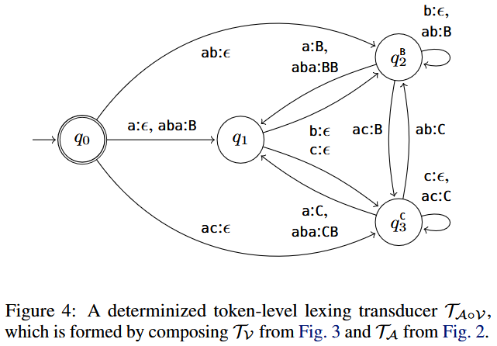
Token-level lexing transducer

Slide 10
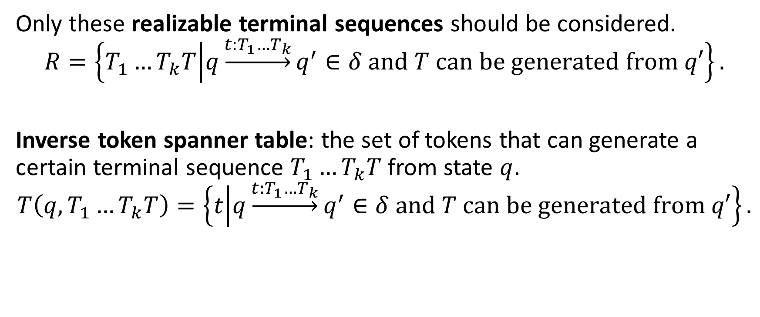
Realizable terminal sequences
Only these realizable terminal sequences should be considered.
$$R=\left\{T_{1}…T_{k}T | q\underset{→}{t:T_{1}…T_{k}}q^{′}∈δ and T can be generated from q′\right\}.$$
Inverse token spanner table: the set of tokens that can generate a certain terminal sequence $T_{1}…T_{k}T$ from state $q$.
$$T\left(q,T_{1}…T_{k}T\right)=\left\{t | q\underset{→}{t:T_{1}…T_{k}}q^{′}∈δ and T can be generated from q′\right\}.$$

Slide 11
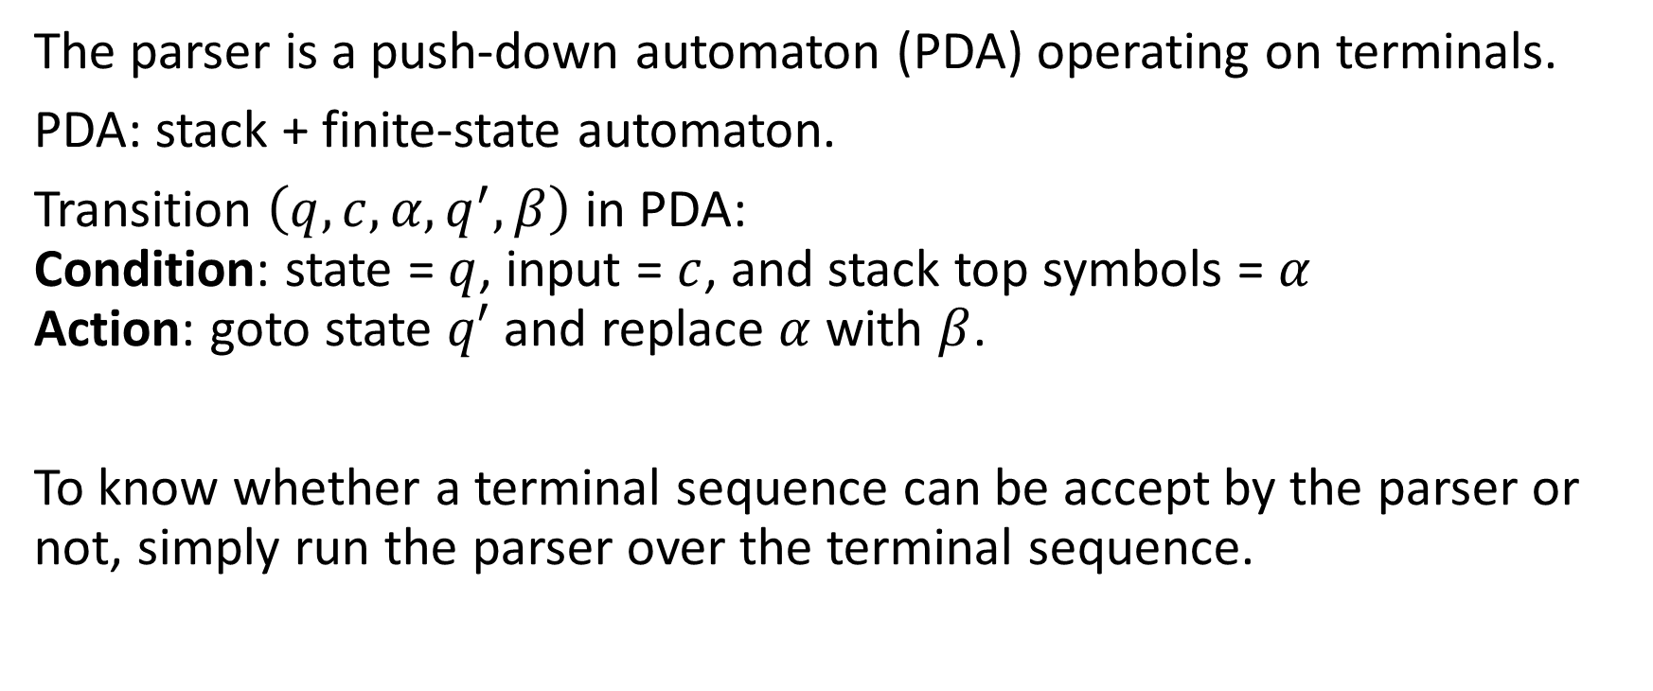
Parser preprocessing
The parser is a push-down automaton (PDA) operating on terminals.
PDA: stack + finite-state automaton.
Transition $\left(q,c,α,q^{′},β\right)$ in PDA: Condition: state = $q$, input = $c$, and stack top symbols = $α$ Action: goto state $q′$ and replace $α$ with $β$.
To know whether a terminal sequence can be accept by the parser or not, simply run the parser over the terminal sequence.

Slide 12
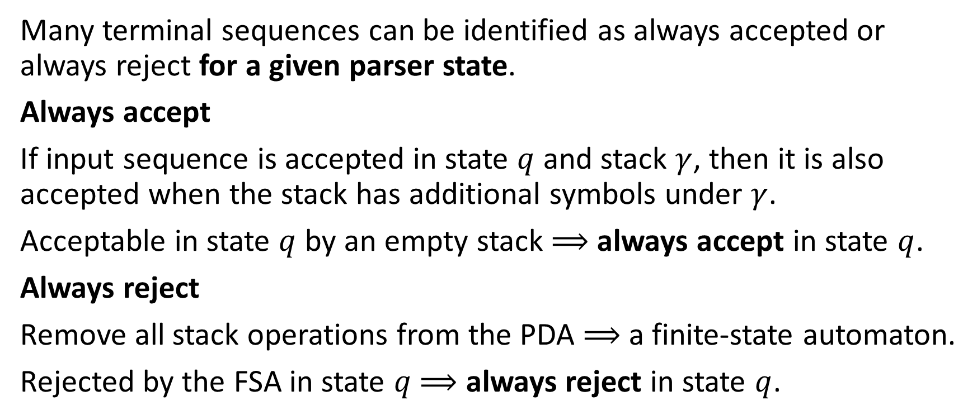
Context dependent/independent tokens
Many terminal sequences can be identified as always accepted or always reject for a given parser state.
Always accept
If input sequence is accepted in state $q$ and stack $γ$, then it is also accepted when the stack has additional symbols under $γ$.
Acceptable in state $q$ by an empty stack $⟹$ always accept in state $q$.
Always reject
Remove all stack operations from the PDA $⟹$ a finite-state automaton.
Rejected by the FSA in state $q$ $⟹$ always reject in state $q$.

Slide 13
Online token masking
tokens = always-accept
For each of the context-dependent terminal sequences
check whether the parser can accept
If accept
tokens += corresponding tokens
Return tokens

Slide 14
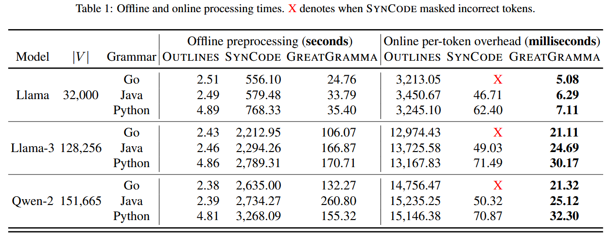
Experiments
Implemented in 900 lines of Python on top of the Lark parser library.

Slide 15
Conclusion
GreatGramma: a tool for grammar-constrained decoding that has both low offline overhead and online overhead.
It captures realizable terminal sequences in a given lexer state. This also speeds up online masking by further reducing the number of inputs the parser has to check during decoding.
The implementation is simple, making it easier to test and easier to develop for future possible research directions.

